Slide 1
Beagle bone activity with Ultrasonic sensor
Internet of Things (IoT)

Slide 2
Topics in the Presentation
Circuit diagram and Beagle bone configuration
Driver Signature Enforcement in Windows 10
Installation of Beagle bone drivers
Taking object measurements using Beagle bone and Ultrasonic sensor

Slide 3
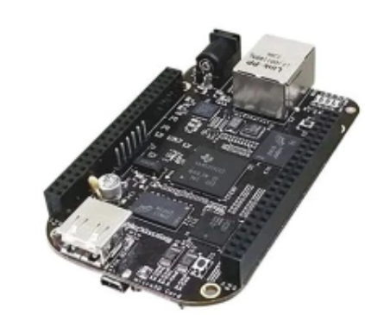
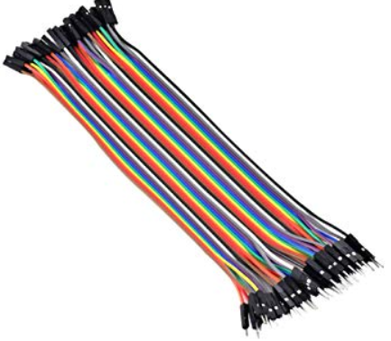
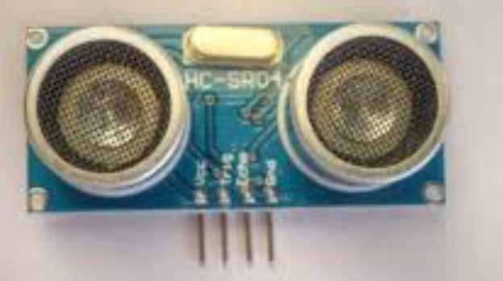
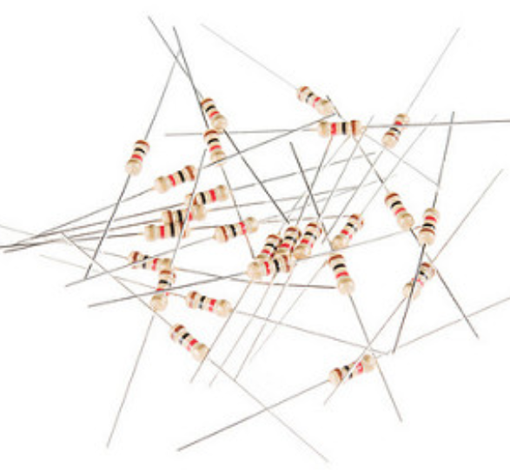
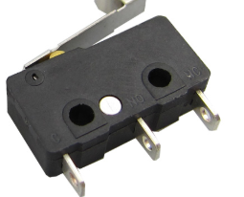
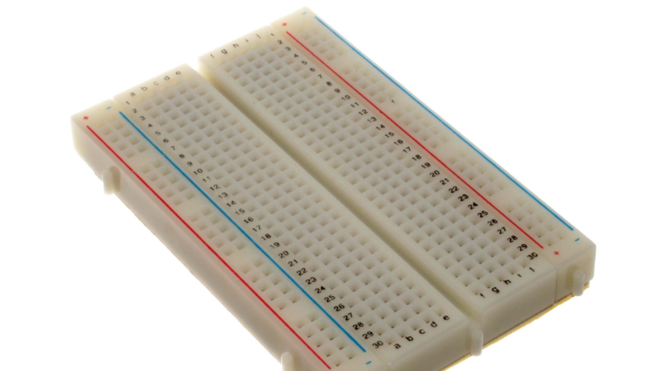
Components required for activity
Beagle bone
Connecting Wires
Ultrasonic Sensor
Resistors 1K
Switch
Breadboard

Slide 4
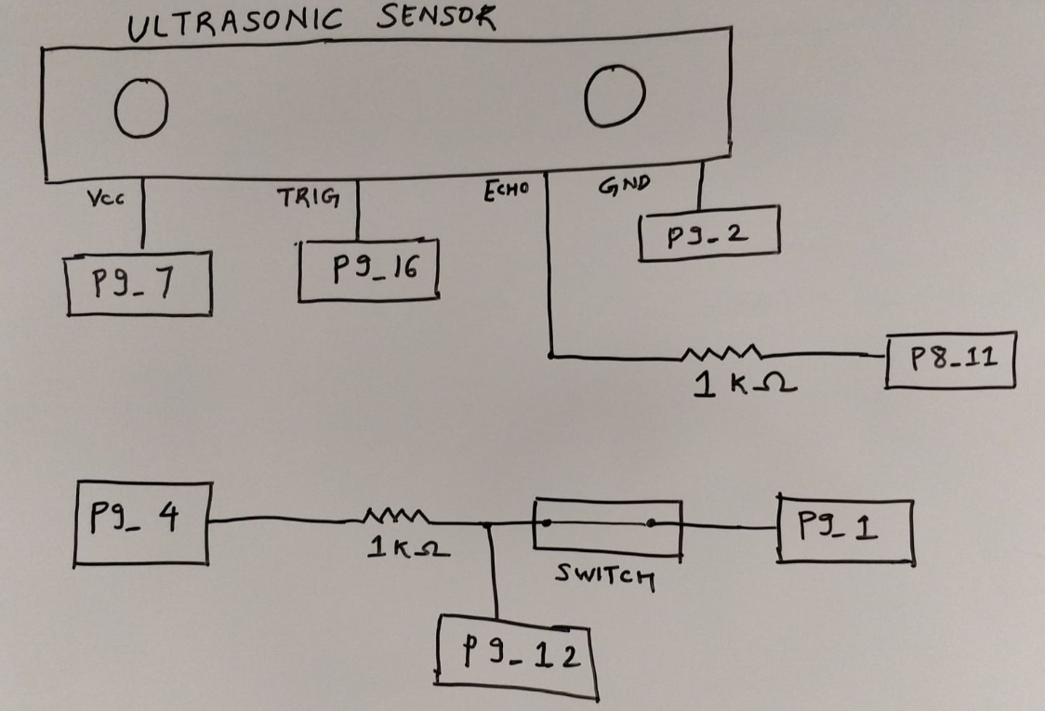
Circuit Diagram

Slide 5
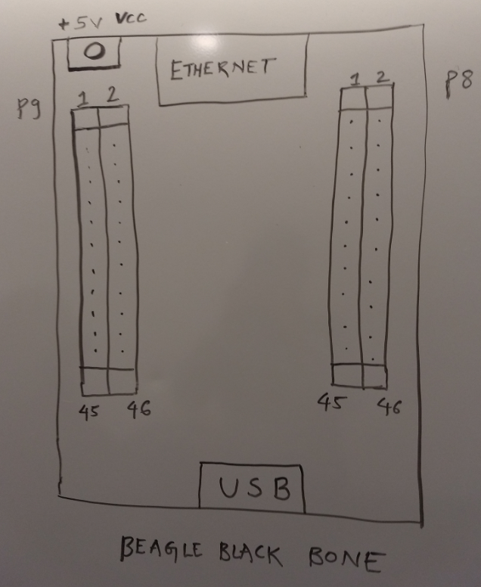
Beaglebone Configuration

Slide 6

Installing Drivers on Windows 10 system
Windows 10 systems require the “Driver Signature Enforcement”, which means they only allow drivers which are verified by Microsoft.
https://windowsreport.com/driver-signature-enforcement-windows-10/

Slide 7
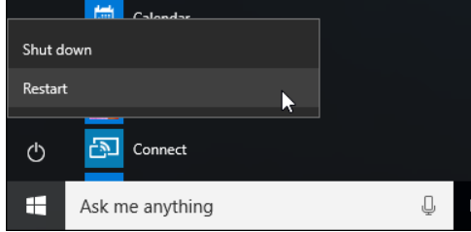
Disable Driver Signature Enforcement
STEP-1:
Restart the system by holding down the Shift Key.

Slide 8
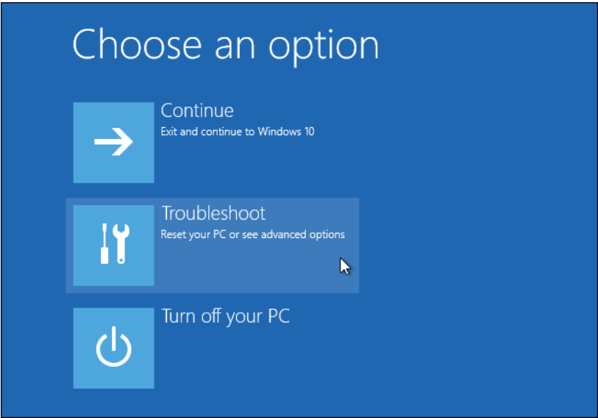
Disable Driver Signature Enforcement
STEP-2:
From the Choose an option screen, select the “Troubleshoot” option.

Slide 9
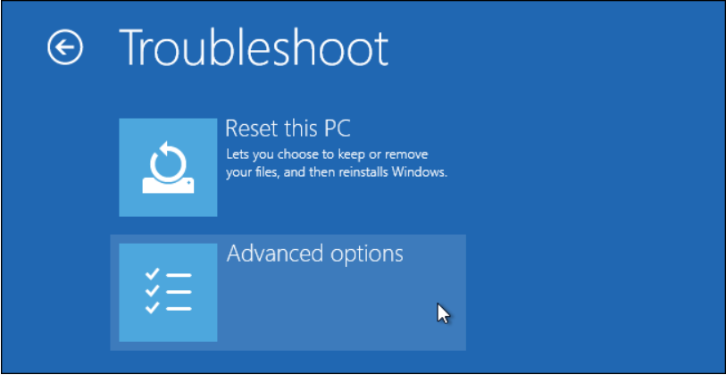
Disable Driver Signature Enforcement
STEP-3:
Select the “Advanced Options” from the Troubleshoot screen.

Slide 10
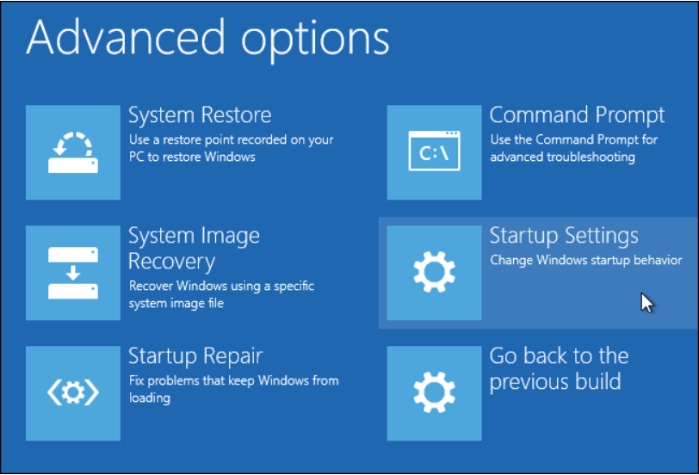
Disable Driver Signature Enforcement
STEP-4:
Select Startup Settings from the Advanced Options page.

Slide 11
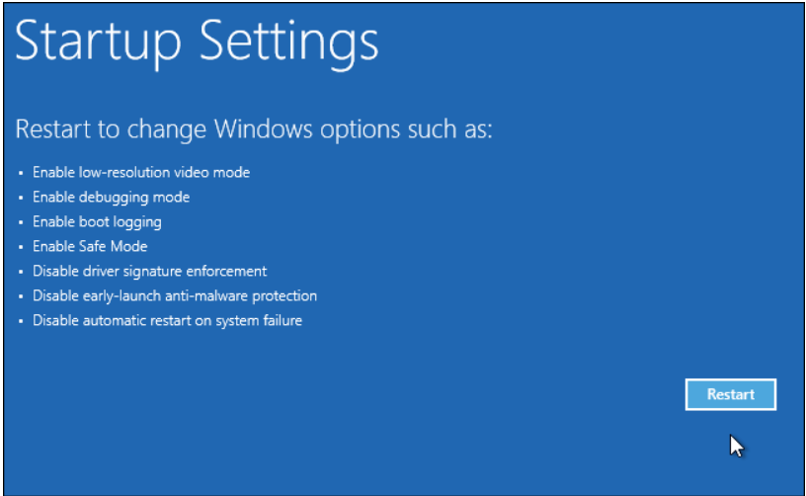
Disable Driver Signature Enforcement
STEP-5:
Click on the Restart button from the Startup Settings Page

Slide 12
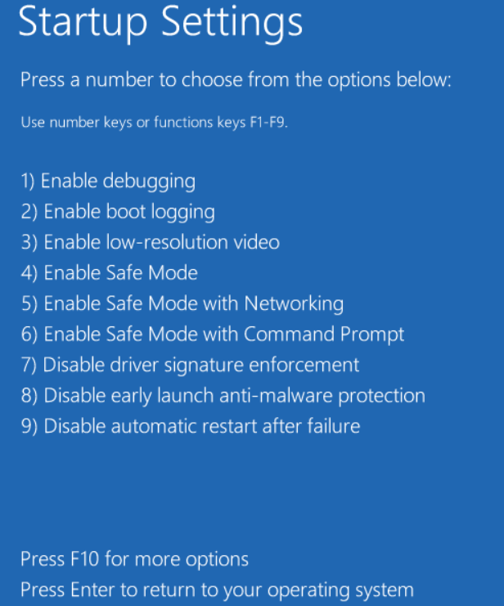
Disable Driver Signature Enforcement
STEP-6:
Press 7 or F7 to disable driver signature enforcement.

Slide 13
Disable Driver Signature Enforcement
The system will now restart with the driver signature enforcement disabled.
And the Beaglebone drivers can be installed on the Windows 10 system.

Slide 14
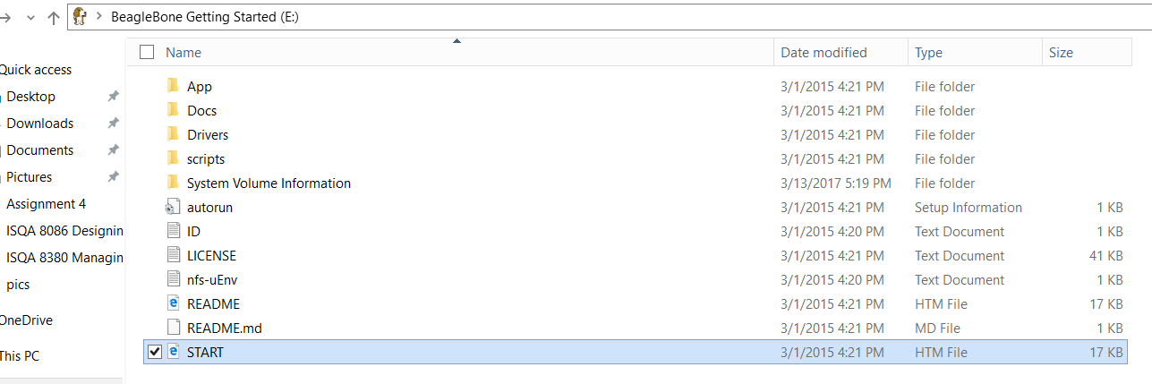
Installing Beagle bone Drivers
Power on the Beagle bone by connecting it to the USB Adaptor, then we have to install the drivers for establishing communication between Beagle bone and the system.

Slide 15
Steps to install Beagle bone Drivers
Installing Drivers is a one time process.
STEP-1:
First Power on the Beaglebone with all the components connected as per the circuit diagram.

Slide 16
Steps to install Beagle bone Drivers
The files containing the beaglebone drivers opens up, click on the Start html file to get information regarding the drivers.

Slide 17
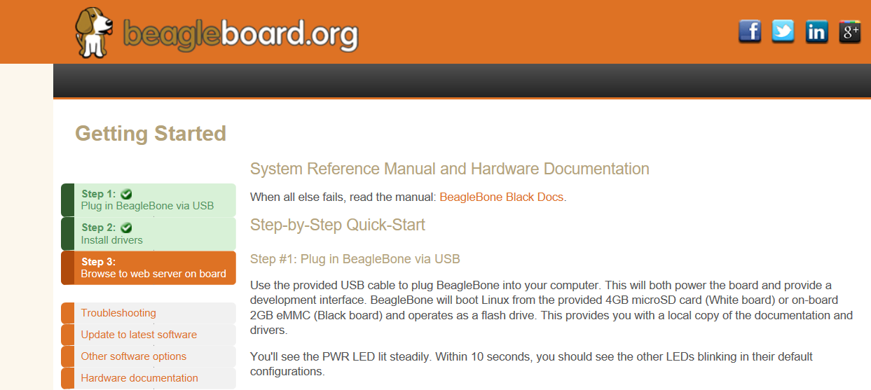
Steps to install Beagle bone Drivers
STEP-3:
After clicking the Start html page, go to the Install drivers section.

Slide 18
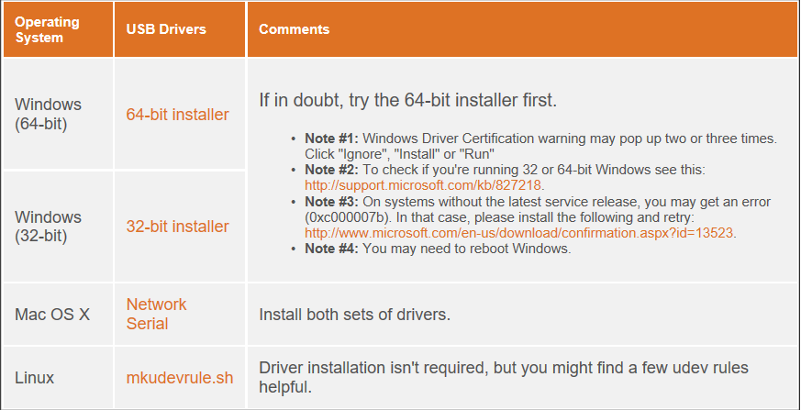
Steps to install Beagle bone Drivers
After selecting the Install Drivers section, select the appropriate driver as per your system configuration.

Slide 19
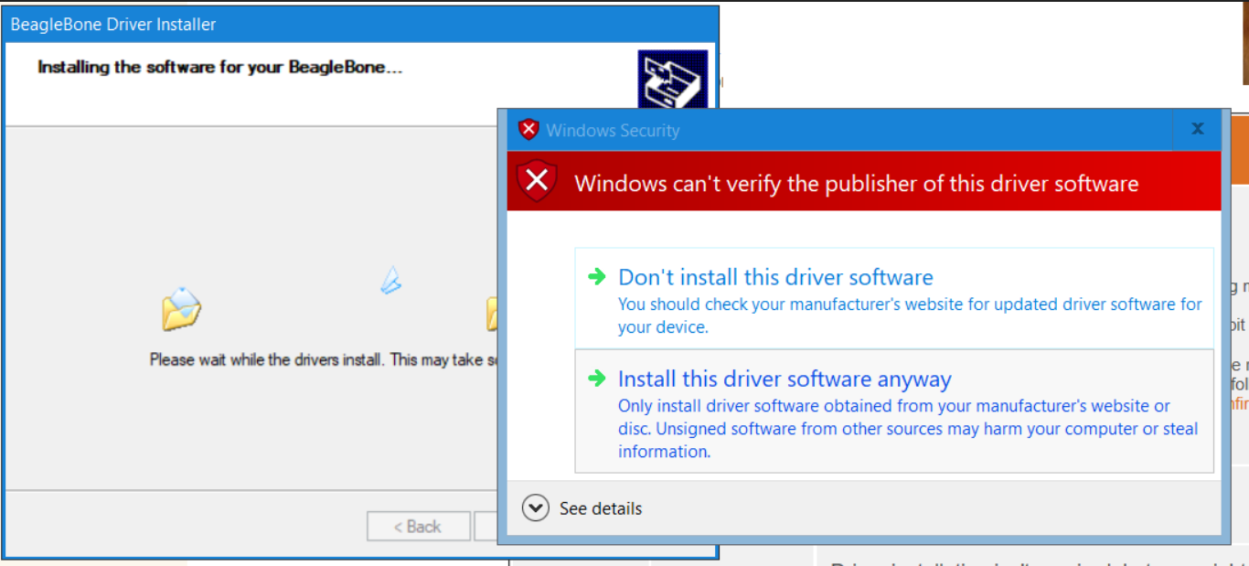
Steps to install Beagle bone Drivers
If you are a Windows 10 users you will come across this message, Select Install this driver software anyway

Slide 20
Steps to install Beagle bone Drivers
Once it is successfully installed, you are ready to use your Beaglebone Device to communicate with your system!

Slide 21
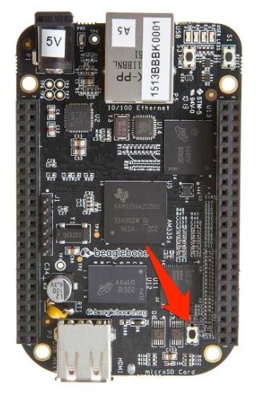
Flashing the code on Beagle bone black
Steps to flash the code on Beaglebone:
Make sure that the Beagle bone is powered on.
Ensure that the MicroSD card in inserted in the Beaglebone slot.
Find the Beaglebone black “User Boot” button, it is located in the same place as the Beaglebone black.

Slide 22
Steps to flash the code on Beaglebone:
Hold the user boot button and then plug in the power.
Hold the button until the four LED lights power on.
Hold the LED button until you see the LED’s powered on, then release the button.
It will take approximately around 30 to 45 minutes to flash the image on the chip

Slide 23
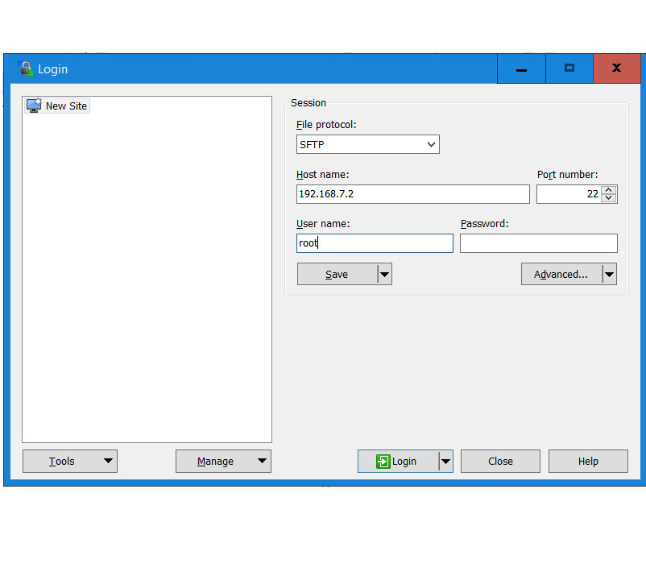
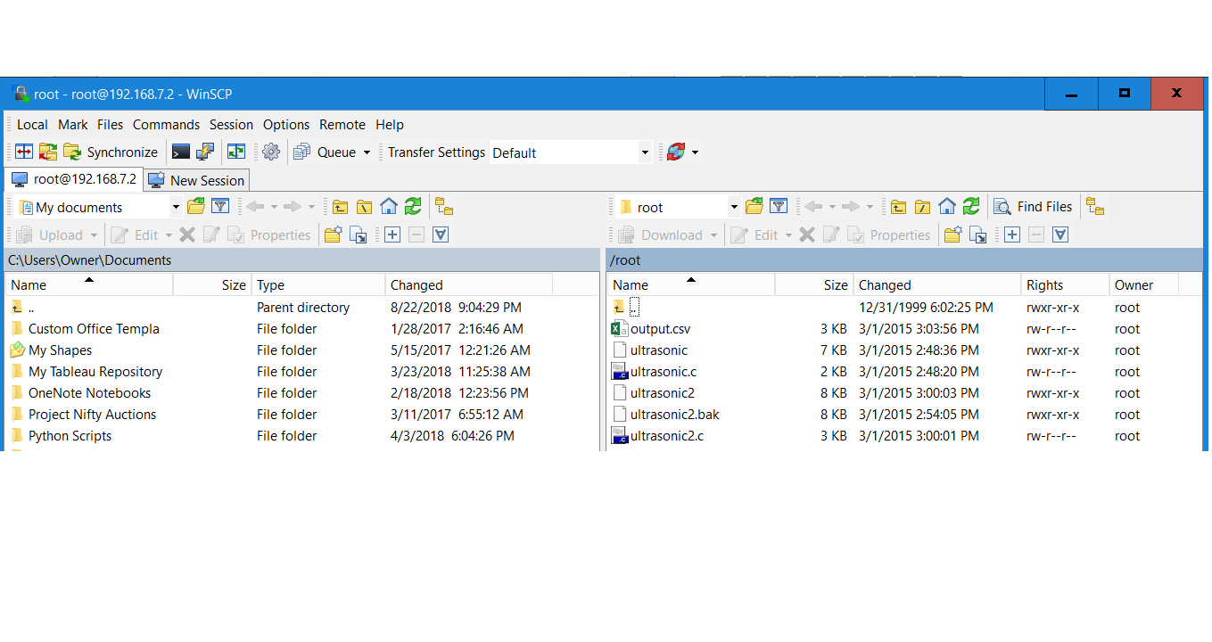
Measuring the Object Distance
After you have connected the circuit, and connected the circuit with the system, you can see the files present in the beaglebone.

Slide 24
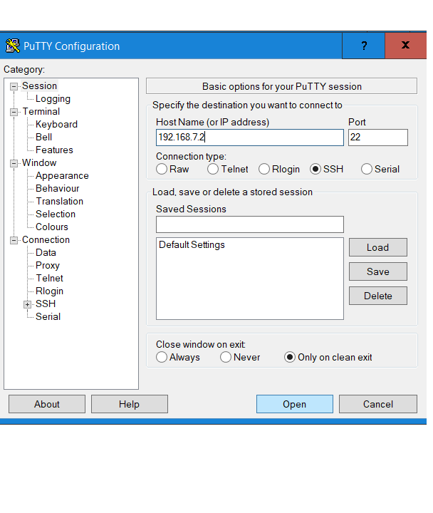
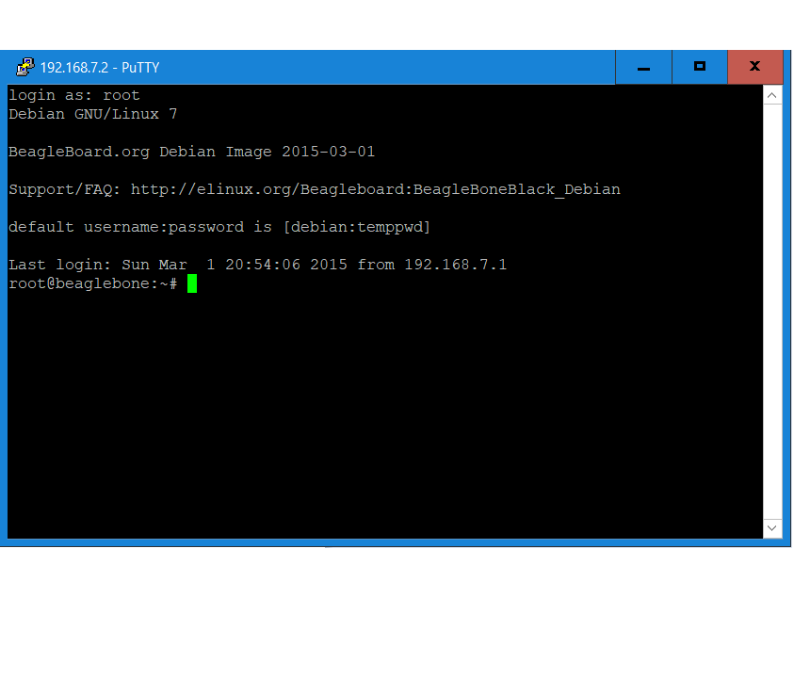
Calculate the distance using Ultrasonic sensor
Open the IDE of your choice preferably PuTTy to run the Ultrasonic file.

Slide 25
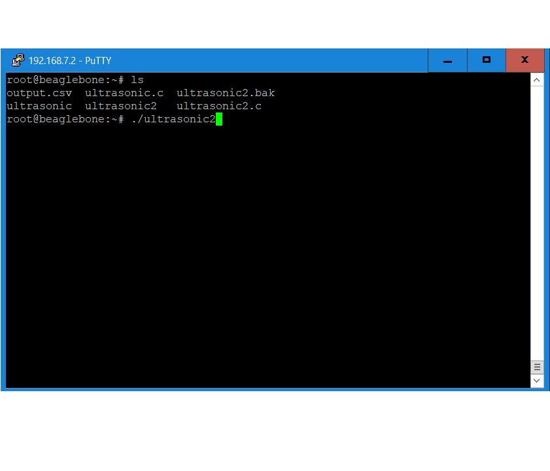
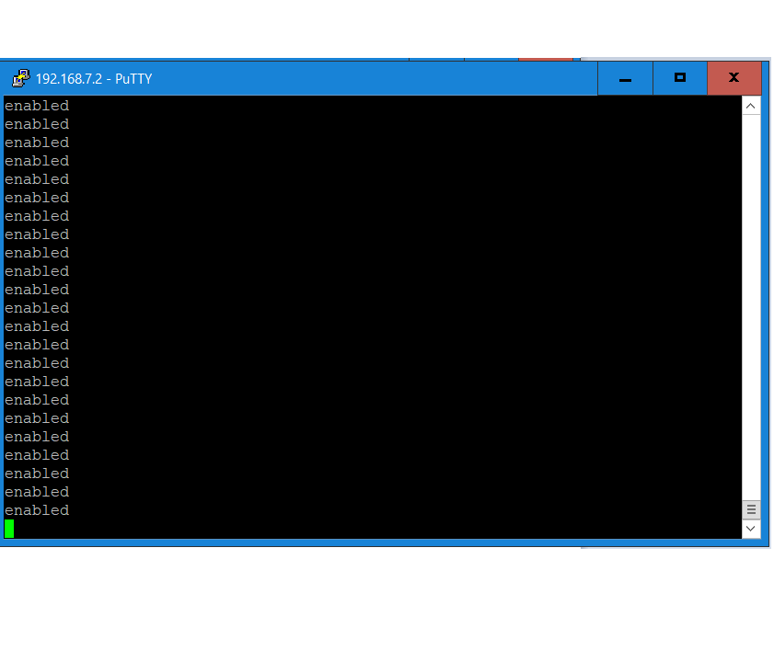
RUN THE ULTRASONIC FILE
Run the File ultrasonic2.c

Slide 26
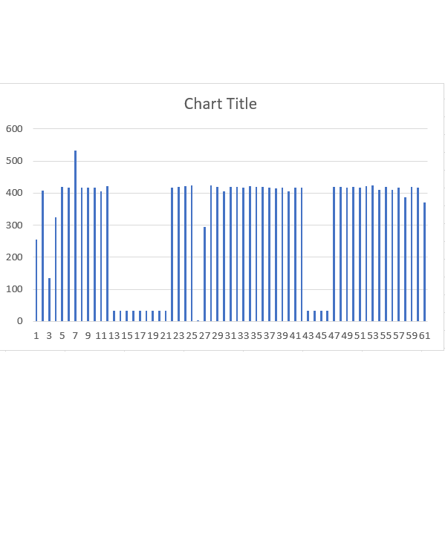
Plot the output from the sensor

Slide 27
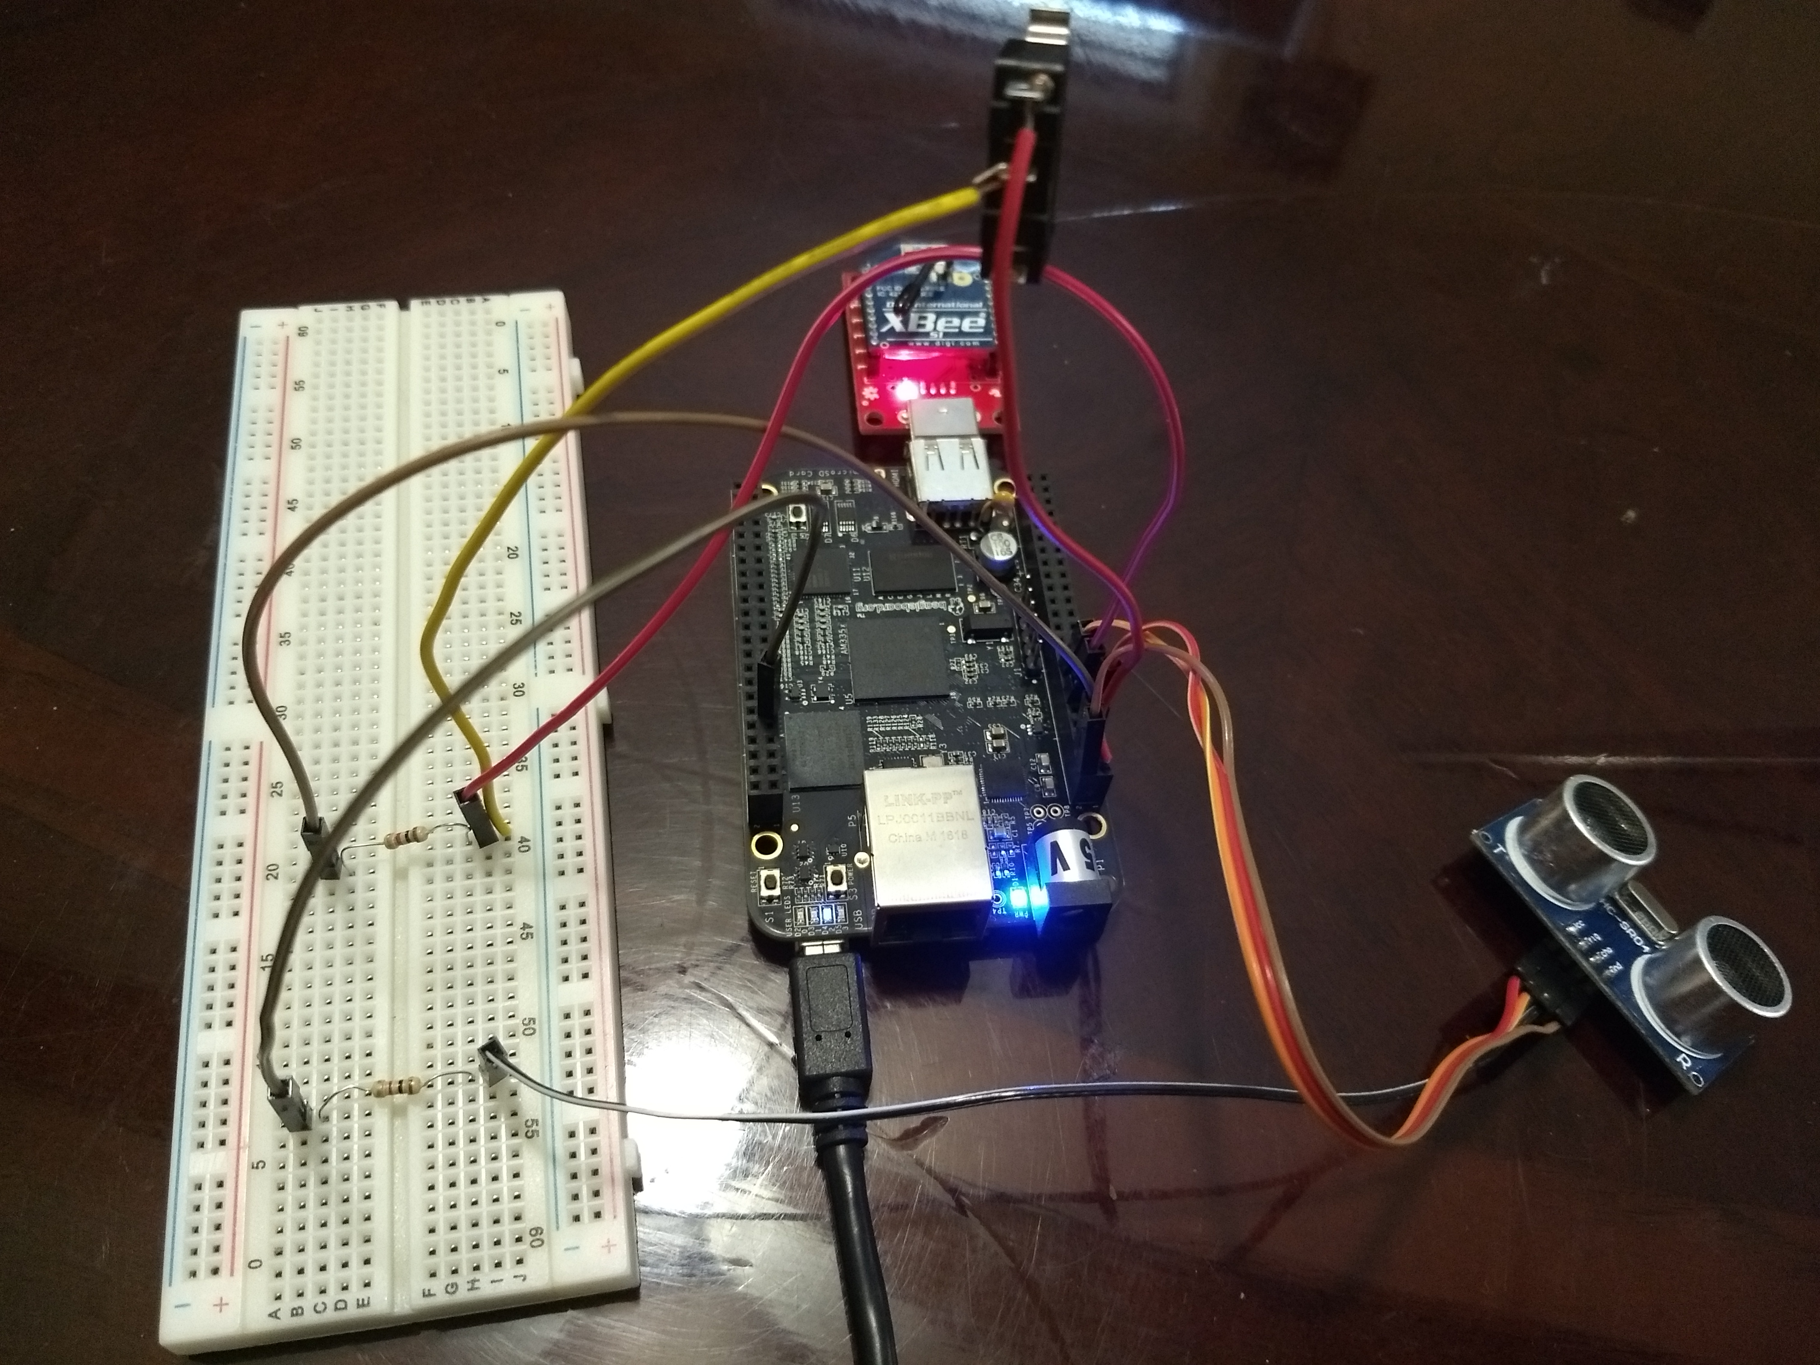
Circuit Connection

Slide 28
Beaglebone and Ultrasonic activity without XBee
Connect the components as per the circuit diagram
Perform the activity without the XBEE connected to the Beagle bone circuit.
Take the measurements from the ultrasonic sensor as done previously.

Slide 29
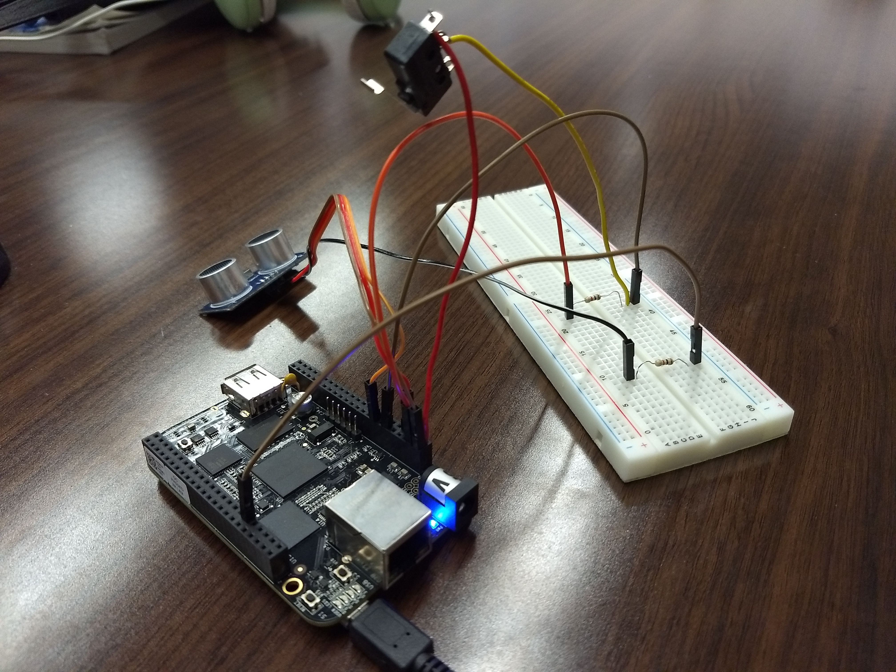
Beaglebone connection without XBee

Slide 30
Link to Source Code
Link to the Source code on GitHub:
https://github.com/SachinPawaskarUNO/codecrush-iot/blob/master/activities/ultrasonic/ultrasonic2.c

Slide 31
Notes:
DO NOT DELETE THIS SLIDE. Please keep at the end of your presentation.

